Slide 1

Face Indexing On Image Data, Recognition, Tracking And Modeling
Course Title : Machine Learning Lab
Course Code : IT 436
To Md. Mynoddin By Chayyan Kar Joy
Lecturer ID: 16155002
Dept. of IT , UITS Rima Akter Samira
ID :16155042 BSc in Information Technology

Slide 2
Outline
Idea
Focus
Goal
Fully Automated Face Recognition
Face Recognition approaches
High Dimensional Correlated Data
Transform into ‘Face Space’
Classifiers
Metric
Training

Slide 3
Idea
Facial recognition for a security Robot
Addition to another project
Gain a better understanding of the subject
Derived from work last semester

Slide 4
Focus
Implementation using Python in a Windows based environment
Basic understand of k-nearest neighbors algorithm and OpenCV algorithm
Method and theory behind the General facial recognition method for facial recognition

Slide 5
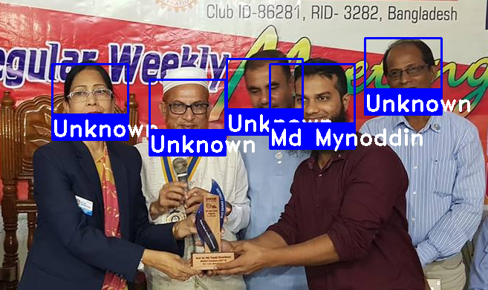
Goal
One half research
General facial recognition methods
One half Implementation
Create a System capable of facial recognition
Real-time
Able to run on a laptop

Slide 6
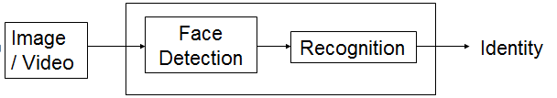
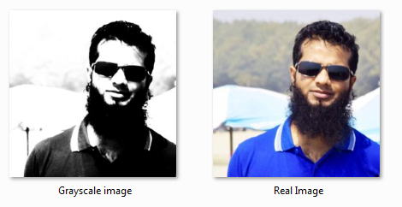
Fully Automated Face Recognition
Face Detection
Color
Motion
Template
Face points

Slide 7
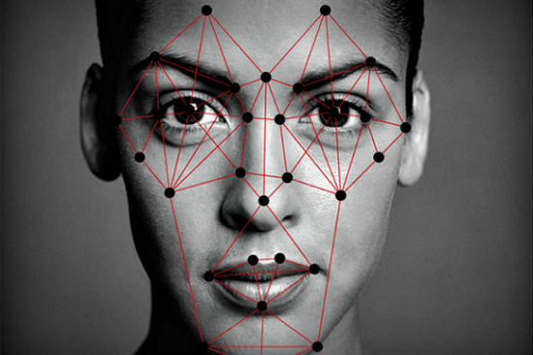
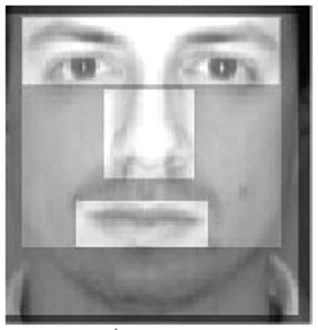
Face Recognition approaches
Geometric features
Find the location of key parts of the face
The distances between them
Template matching
Extract facial regions (matrix of pixels)
and compare with that of known individuals
Need templates for different face views

Slide 8
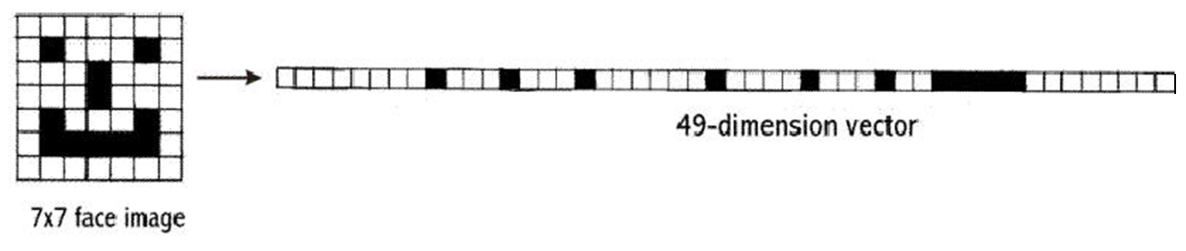
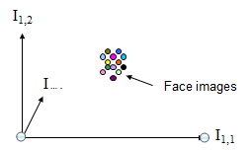
High Dimensional Correlated Data
Images as a high dimensional vector
A typical image used for image
processing will be
512x512= 262144
dimension vector!
(Registered) face images
are highly correlated

Slide 9
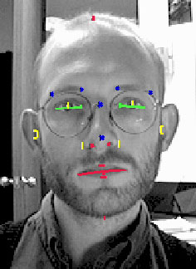
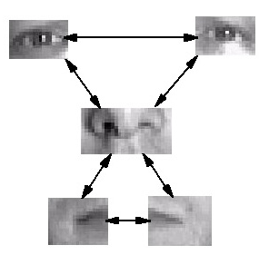
Learning Task
Face recognition problem: Whose face is this in the picture?
Hard to model describing face and its components

Slide 10
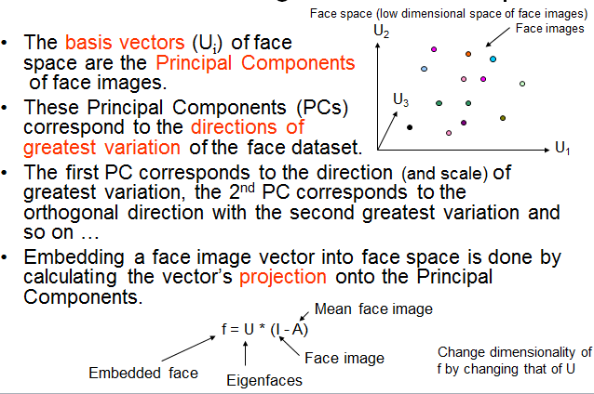

Transform Face images to a ‘Face Space’

Slide 11
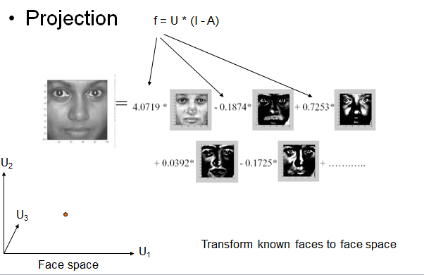
Transform into ‘Face Space’

Slide 12
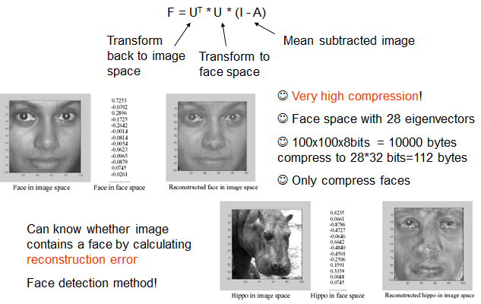
Reconstruction

Slide 13

Classifiers
Classify an unknown face into one of the known face classes
Important concepts
Inter-class (between-class) variance
Intra-class (within-class) variance
Need a metric to measure distance for class membership

Slide 14
Metric
A non-negative function g(x,y) describing the "distance" between face points for a given set and satisfies
g(x,y)+g(y,z)≥g(x,z) (triangle inequality)
g(x,y)=g(y,x) (symmetry)
g(x,x)=0, as well as g(x,y)=0 x=y

Slide 15
Training
Used the camera to capture images
Images were then cropped and resized
Model was trained using positive and negative images
Creates training file that holds the M-Dimensional face space
Model=cv2.createElgenfaceRecognizer()
Model.train(np.asarray(faces),np.asarray(labels))

Slide 16
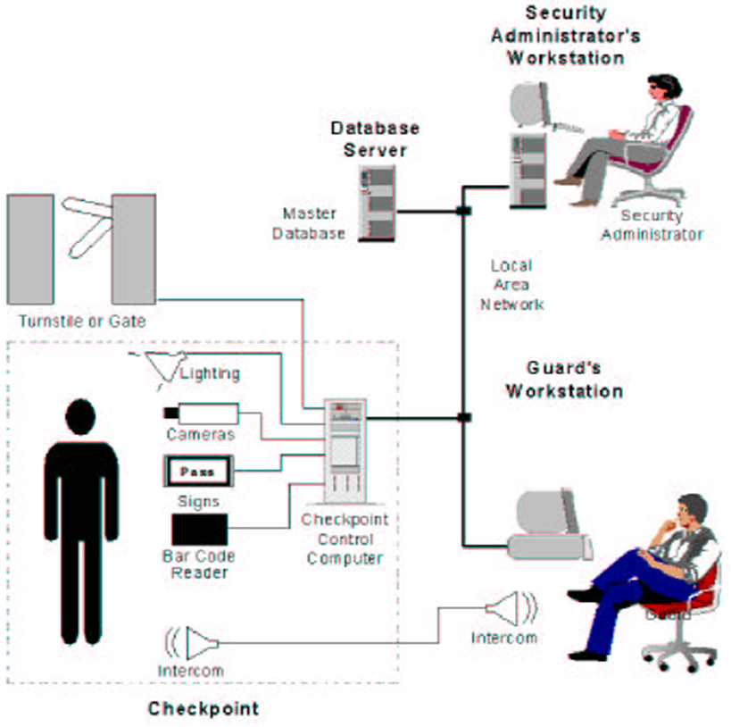
Applications of Face Recognition
Access Control
Face Databases
Face ID
HCI - Human Computer
Interaction
Law Enforcement
Multimedia Management
Security
Smart Cards
Surveillance
Others

Slide 17

Any Question?

Slide 18

Thank you!

